Slide 1
Monroe Doctrine
And other foreign policy matters of the early 1800’s
Primary Source: The Americans, McDougal Littell
Images as cited.
Presentation created by Robert Martinez

Slide 2
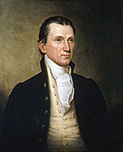
Foreign affairs dominated the first term of President James Monroe, who was elected in 1816.
http://www.mssdar.org/jmonroe/images/jamesmonroeuse.jpg

Slide 3
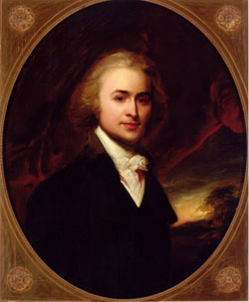
His secretary of state, John Quincy Adams, established a foreign policy based on nationalism, a belief that national interests should be placed ahead of regional concerns, such as slavery in the South or tariffs in the Northeast.
http://www.google.com/imgres?imgurl=http://www.aoc.gov/images/monroe.jpg&imgrefurl=http://americanpicturelinks.com/06ja.htm&usg=__4Rt0Em8PXYDytnpSxREF5R1J7gY=&h=442&w=520&sz=38&hl=en&start=12&zoom=1&tbnid=Fa8ibgZQdkpG2M:&tbnh=111&tbnw=131&ei=dB-mTpdVtKywAvHf1bkP&prev=/images%3Fq%3Dsecretary%2Bof%2Bstate%2Bjohn%2Bquincy%2Badams%26hl%3Den%26gbv%3D2%26tbm%3Disch&itbs=1

Slide 4
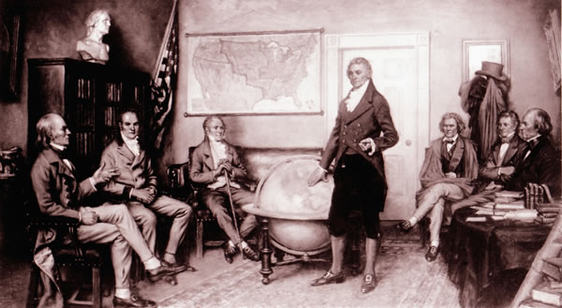
High on Adam’s list of national interests were the security of the nation and the expansion of its territory.
http://www.usdiplomacy.org/exhibit/images/monroe.jpg

Slide 5
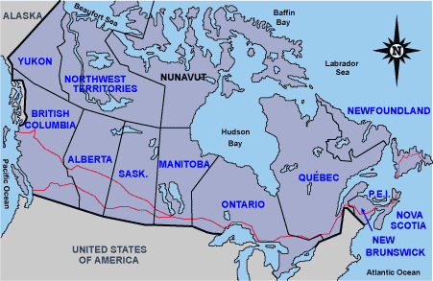
Adams arranged the convention of 1818, which fixed the U.S. border at the 49th parallel from Michigan west to the Rocky Mountains.
http://msmvps.com/cfs-filesystemfile.ashx/__key/CommunityServer.Blogs.Components.WeblogFiles/robfarley.TheproblemwithAmericaspatialdata_5F00_14EE8/image_5F00_3.png

Slide 6
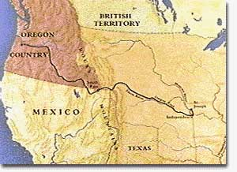
Adams also reached a compromise with Britain to jointly occupy the Oregon Territory, the territory west of the Rockies, for ten years.
http://www.ushistory.org/us/images/00000411.jpg

Slide 7
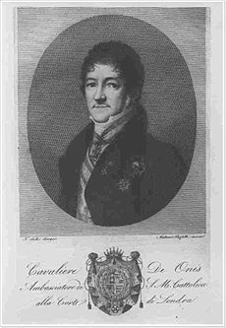
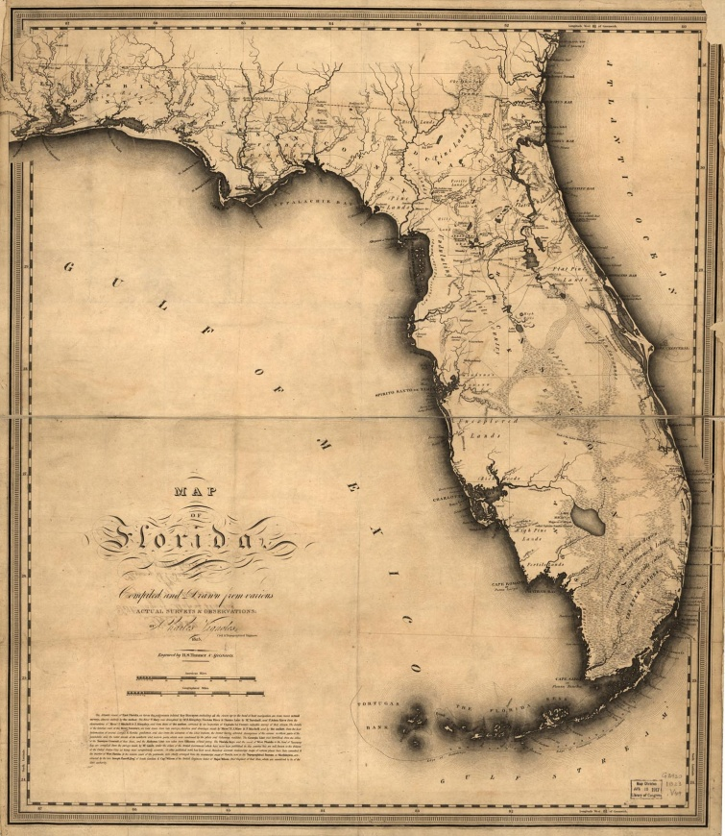
Adams also convinced Don Luis de Onis, the Spanish minister to the United States, to transfer Florida to the United States.
http://upload.wikimedia.org/wikipedia/en/thumb/b/bb/Luis_de_onis.jpg/230px-Luis_de_onis.jpg
http://www.sonofthesouth.net/texas/pictures/florida-map-1500.jpg

Slide 8
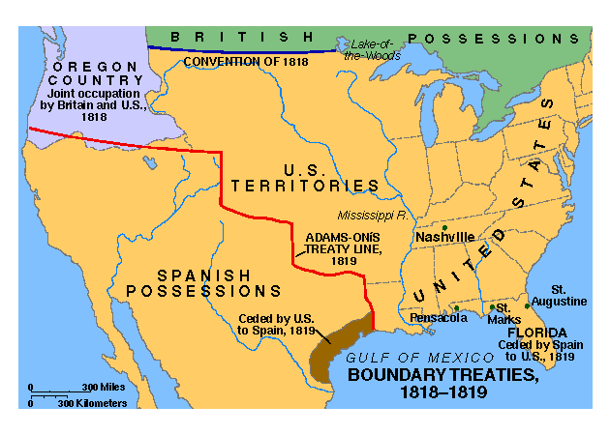
The Adams-Onis Treaty also established a western boundary for the U.S. that extended along the Sabine River from the Gulf of Mexico north to the Arkansas River to its source, and then north to the 42nd parallel, and west to the Pacific Ocean.
http://mrcapwebpage.com/VCSUSHISTORY/adamsonistreaty.gif

Slide 9
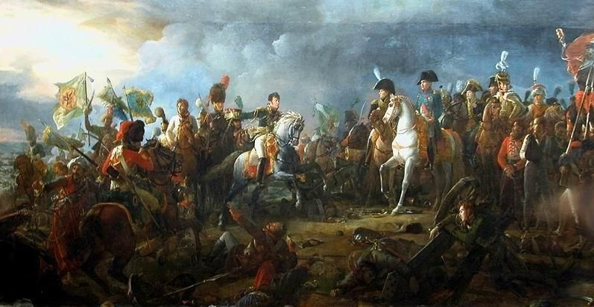
When Napoleon invaded Portugal and Spain in 1807, the two countries did not have the money or military force to both defend themselves and keep control of their overseas territories at the same time.
http://img3.ranker.com/list_img/1/299087/full/a-list-of-the-napoleonic-wars-battles-involving-kingdom-of-portugal.jpg?version=1292516383000

Slide 10
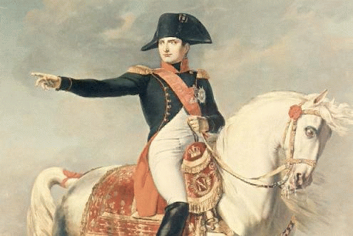
But when Napoleon was defeated in 1815, Portugal and Spain wanted to reclaim their former colonies in Latin America.
http://jspivey.wikispaces.com/file/view/horse.gif/31492583/horse.gif

Slide 11
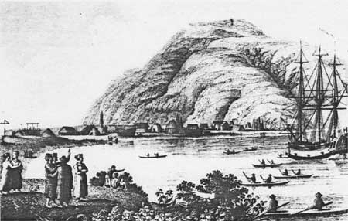
Meanwhile, the Russians, who had been in Alaska since 1784, were establishing trading posts in what is now California.
http://www.google.com/imgres?imgurl=http://www.nps.gov/history/history/online_books/nhl/russian-america/images/fig8-7.jpg&imgrefurl=http://www.nps.gov/history/history/online_books/nhl/russian-america/sec8.htm&usg=__VVzcUOnTvHFS3rPUKxgEv1TK0Mo=&h=286&w=450&sz=26&hl=en&start=4&zoom=1&tbnid=GX6fnqb4zTLsKM:&tbnh=81&tbnw=127&ei=VCamTp3SNa_ksQLquISsDw&prev=/images%3Fq%3Drussian%2Btrading%2Bpost%2Bnorth%2Bamerica%26hl%3Den%26gbv%3D2%26tbm%3Disch&itbs=1

Slide 12
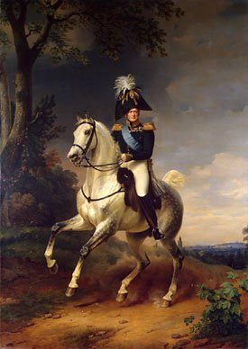
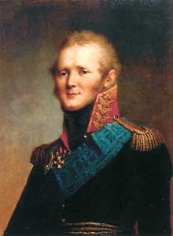
In 1821, Czar Alexander I of Russia claimed that Alaska’s southern boundary was the 51st parallel, just north of Vancouver Island. He forbade foreign vessels from using the coast north of this line.
http://www.fortunecity.com/victorian/hornton/890/czar/alexander1.jpg
http://www.reformation.org/en-czar-alexander1.jpg

Slide 13
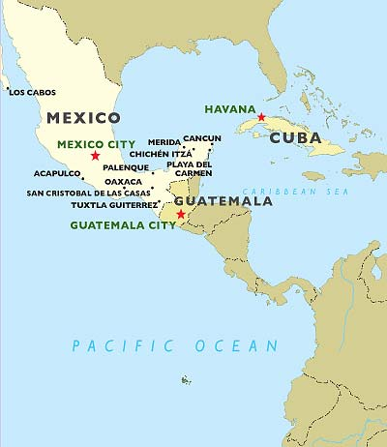
Many Americans were interested in acquiring northern Mexico and the Spanish colony of Cuba. Moreover, the Russian action posed a threat to American trade with China, which brought huge profits.
http://www.worldjourneys.co.nz/admin/upload-images/packageMap-Viva!Mexico-Cuba.jpg

Slide 14
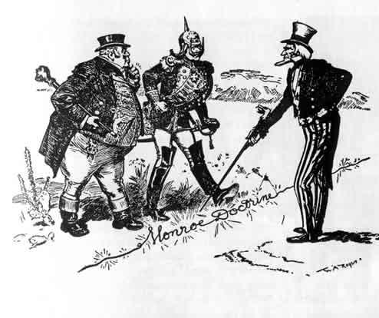
Accordingly, in his 1823 message to Congress, President Monroe warned all European powers not to interfere with affairs in the Western Hemisphere.
http://deskofbrian.com/wp-content/uploads/Monroe-Doctrine-cartoon.jpg

Slide 15
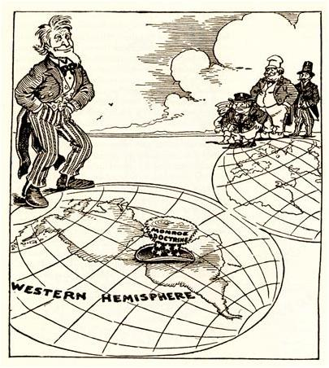
They should not attempt to create new colonies, he said, or try to overthrow the newly independent republics in the hemisphere.
http://hseuspics.wikispaces.com/file/view/SS4.JPG

Slide 16
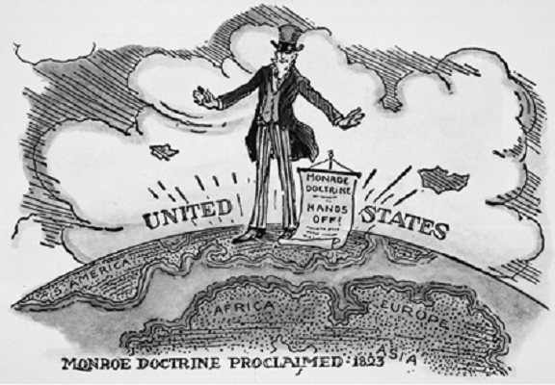
The U.S. would consider such action “dangerous to our peace and safety.” At the same time, the U.S. would not involve itself in European affairs or interfere with existing colonies in the Western Hemisphere.
http://www.sms.rcs.k12.tn.us/TEACHERS/bryans/unit%2010%20jefferson_clip_image002.gif

Slide 17
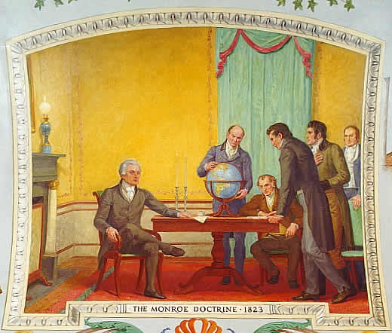
These principles became known as the Monroe Doctrine. The doctrine became a foundation for future American policy and represented an important step onto the world stage by the assertive young nation.
http://www.google.com/imgres?imgurl=http://www.aoc.gov/images/monroe.jpg&imgrefurl=http://americanpicturelinks.com/06ja.htm&usg=__4Rt0Em8PXYDytnpSxREF5R1J7gY=&h=442&w=520&sz=38&hl=en&start=12&zoom=1&tbnid=Fa8ibgZQdkpG2M:&tbnh=111&tbnw=131&ei=dB-mTpdVtKywAvHf1bkP&prev=/images%3Fq%3Dsecretary%2Bof%2Bstate%2Bjohn%2Bquincy%2Badams%26hl%3Den%26gbv%3D2%26tbm%3Disch&itbs=1

Slide 18
Why was the Monroe Doctrine an important policy?
It stated a new policy for European countries creating colonies in the West.
It allowed the United States to get involved in European matters.
It encouraged European countries to get involved in United States matters.
It showed no respect for existing governments in the Western Hemisphere.

Slide 19
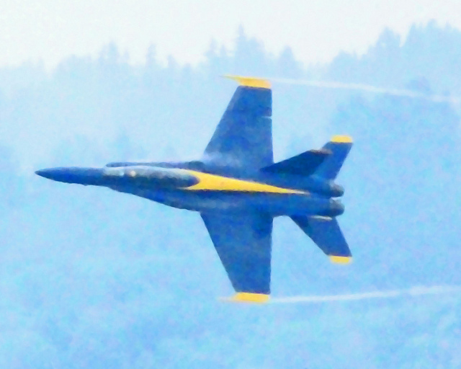
What cities, states and countries have you visited? How did you travel there?

Slide 20
In this next section, you will learn how improvements in transportation affected travel and transportation during the early 1800s.
Please turn to page 332 in the Call To Freedom textbook.

